Slide 1
Introduction to Emerging Technologies
Chapter Three
Artificial Intelligence (AI)

Slide 2
Outline
Definitions
History
Levels of AI
Types of AI
Influencers of Artificial Intelligence
Applications of AI
AI Tools and Platforms
Sample Applications

Slide 3
Introduction
In the previous chapter we have looked over data science, data acquisition, analysis and storage. Basic concepts of big data were also reviewed.
In this chapter; history, types, and applications of AI will be examined. Tools and platforms, as well as sample AI applications, shall be discussed.

Slide 4
Learning outcomes
After completing this chapter you should be able to:
Explain what artificial intelligence (AI) is.
Describe the ages of AI.
Explain the types and approaches of AI.
Describe applications of AI in health, agriculture, business and education.
List factors that influenced the advancement of AI in recent years.
Understand the relationship between human’s way of thinking and AI systems
Identify AI research focus areas.
Identify real-world AI applications, platforms, and tools.

Slide 5
AI Defined
Artificial Intelligence (AI) as the branch of computer science by which we can create intelligent machines which can behave like humans, think like humans, and are able to make decisions. (adopted by MOSHE)
AI is an umbrella term for “smart” technologies that are aware of and can learn from their environments. AI enables machines to sense their environments, think, learn and respond on their own, becoming increasingly autonomous. Governance Insights Center, 2017
Notes:
Artificial: man made, not natural
Intelligence: the ability to acquire and apply knowledge and skills. Oxford dictionary
AI is man-made ability to reason, learn and solve problems (or take appropriate actions to stimuli).
AI is the study of ideas that enable computers to be intelligent.
AI is the part of computer science concerned with design of computer systems that exhibit human intelligence (From the Concise Oxford Dictionary).
Umbrella: AI is more than just a single independent technology. It includes many different parts (fields).
[Q] Can you give examples of technologies which incorporate AI into their operations?
Robotic Process Automation (RPA), NLP, Machine Learning, and Neural Networks, PDAs, Autonomous Vehicles…

Slide 6
Definitions Continued…
Machine learning (AI) allows computer systems to learn from data and recognize patterns, predict outcomes, assist humans with understanding or suggest actions (becoming “smart”) without being explicitly programmed.
Among other things, machine learning (AI) can inform decision-making and make process automation more flexible.
Notes:
In the way humans are behaving. Thus, AI is replicating human behavior in to machines.
They do this by recognizing and interpreting digitized text, sound and images, making it possible to answer questions, suggest solutions and diagnose problems or take actions. As a result, AI can reduce the amount of rote (routine) work humans are faced with everyday.

Slide 7
Definitions Continued…
Artificial Intelligence exists when machines can attain human-based skills such as learning, reasoning, and taking actions by their own.
Intelligence is composed of:
Reasoning
Learning
Problem Solving
Perception
Linguistic Intelligence
Notes:
Reasoning: The power of the mind to think, understand, and form judgments logically.
Learning: Knowledge or skills acquired through experience or study or by being thought.
Problem solving:
Machine perception is the ability to use input from sensors (cameras, microphones, other sensors, etc.) to deduce aspects of the world. e.g., Computer Vision.
Linguistic Intelligence: For understanding natural languages, discover meaning

Slide 8
Systems that act like humans Turing Test
The Turing Test approach
a human questioner cannot tell if
there is a computer or a human answering his question, via teletype (remote communication)
The computer must behave intelligently
Intelligent behavior
to achieve human-level performance in all cognitive tasks
Notes:
Alan Turing: If it passes the test, we conclude it is an intelligent system.

Slide 9
What is Intelligence? The Turing Test
A machine can be described as a
thinking machine if it passes the
Turing Test. i.e. If a human agent is engaged in two isolated dialogues (connected by teletype say); one with
a computer, and the other with
another human and the human agent cannot reliably identify which dialogue is with the computer.

Slide 10
The total Turing Test
Includes two more issues:
Computer vision
to perceive objects (seeing)
Robotics
to move objects (acting)

Slide 11
Objections to the TT
The Theological Objection
"Thinking is a function of man’s immortal soul. God has given an immortal soul to every man and woman, but not to any other animal or to machine. Hence no animal or machine can think."
The “Head in the Sand” Objection
"The consequences of machines thinking are to dreadful to think about."

Slide 12
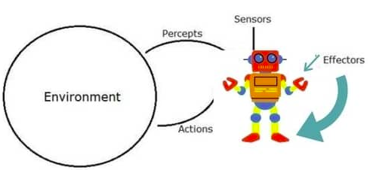
AI Systems
An AI system can be visualized as composed of an agent and its environment. An agent (e.g., human or robot) is anything that can perceive its environment through sensors and acts upon that environment through effectors.
Intelligent agents must be able to set goals and achieve them
Notes:
Intelligent agents must be able to set goals and achieve them.
In classical or ideal cases (of planning to solve problems), the agent can assume that it is the only system acting in the world, allowing the agent to be certain of the consequences of its actions.
However, if the agent is not the only actor, then it requires that the agent can reason under uncertainty. This calls for an agent that cannot only assess its environment and make predictions but also evaluate its predictions and adapt based on its assessment.
Effector: An organ or cell that acts in response to a stimulus.

Slide 13
AI Systems Continued…
High-profile examples of AI include autonomous vehicles (such as drones and self-driving cars), medical diagnosis, creating art (such as poetry), proving mathematical theorems, playing games (such as Chess or Go), search engines (such as Google search), online assistants (such as Siri), etc.
Notes:
Image recognition in photographs, spam filtering, prediction of judicial decisions and targeting online advertisements.

Slide 14
AI Systems Continued…
AI deals with the area of developing computing systems that are capable of performing tasks that humans are very good at, for example recognizing objects, speech recognition, and decision making in a constrained environment.
Machine Learning (ML) is an advanced form of AI where the machine can learn as it goes rather than having every action programmed by humans.

Slide 15
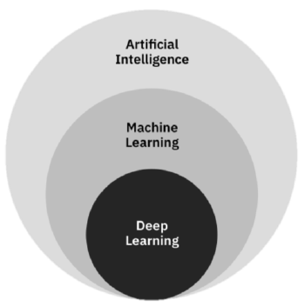
AI Systems Continued…
Relationships of AI, ML, and DL
Deep learning (DL) is a field of neural networks with several hidden layers.
Notes:
Deep learning replicates (imitates) the human neural system.
Neural networks are biologically inspired networks that extract features from the data in a hierarchical fashion.
Neural: Relating to a nerve or the nervous system.
Neuron: A specialized cell transmitting nerve impulses (impetus, driving force).

Slide 16
Need for Artificial Intelligence
To create expert systems that exhibit intelligent behavior with the capability to learn, demonstrate, explain and advice its users.
Helping machines find solutions to complex problems like humans do and applying them as algorithms in a computer-friendly manner.
Notes:
Why we need AI at this time? Our goal to achieve through AI?

Slide 17
Goals of Artificial Intelligence
Replicate human intelligence
Solve Knowledge-intensive tasks
An intelligent connection of perception and action
Building a machine which can perform tasks that requires human intelligence such as:
Proving a theorem
Playing chess (or other skill games)
Plan and execute some surgical operation
Driving a car in traffic
Notes:
Some of the main goals of artificial intelligence are listed here.

Slide 18
What Comprises of AI?
Intelligence is an intangible part of our brain which is a combination of Reasoning, learning, problem-solving, perception, language understanding, etc.
To impart these qualities into machines, Artificial Intelligence requires the following disciplines
Mathematics
Biology
Psychology
Sociology
Computer Science
Neurons Study
Statistics
Notes:
AI is not only part of computer science, but it encompasses many disciplines as shown here.
Can AI systems have moral? Faith? Feelings? Is this an emerging AI?

Slide 19
Reading Assignment: Advantages and Disadvantages of AI

Slide 20
History of AI
Artificial Intelligence is not a new discipline and not a new technology for researchers.
Milestones in the history of AI are shown in the following slide.
Notes:
AI is the part of computer science concerned with design of computer systems that exhibit human intelligence.
Milestones: Great advances, indicators, landmarks.

Slide 21
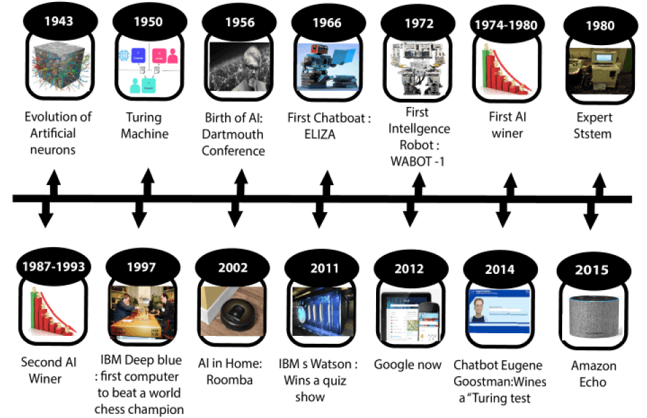
History of AI in pictures…
Winter
Winter
Notes:
1943: Model of artificial neurons was proposed;
1950: Alan Turing, an English mathematician pioneered Machine learning in 1950 and proposed the Turing test;
1956: the first AI program to prove 38/52 mathematical theorems and the term AI was adopted in USA at a conference;
1972: First humanoid robot developed in japan;
First and Second AI winters; The cold season (period for AI). Refers to the time period where computer scientists dealt with a severe shortage of funding from governments for AI researches. During AI winters, an interest in publicity on artificial intelligence was decreased.
1980: The first expert system was developed;
1993-2011: The emergence of intelligent agents;
2011-to date: Deep learning, big data and remarkable advances in artificial intelligence.
About 80 years since AI was considered as a main subject.

Slide 22
History of AI…
Now AI has developed to a relatively remarkable level. The concept of Deep learning, big data, and data science are now trending.
Companies like Google, Facebook, IBM, and Amazon are working with AI and creating amazing devices. The future of Artificial Intelligence is inspiring and much more is to come.

Slide 23
Levels of AI
As we have mentioned frequently, AI technology machines were anticipated to learn from the perceived environment’s data and to use past experience to make proactive decisions.
And AI never emerged out of the blue or overnight but it has passed & is yet anticipated to pass through various stages (levels).
Notes:
Anticipated: Expected
Proactive: not only responding but also controlling situations.
Therefore, as you can understand from this, some lower levels are realized while higher levels are only predictions or likely realizable anticipations.
What are these anticipated higher levels of AI?
There are seven levels of AI, in which the higher levels are strongly & possibly believed to be realized in the future.

Slide 24
Levels of AI
Level 1: Rule-Based Systems
The most common uses of AI today fit in this category, covering everything from business software (Robotic Process Automation) and domestic appliances to aircraft autopilots.
Notes:
RPA ++
If then rules.

Slide 25
Levels of AI …
Level 2: Context Awareness and Retention
Algorithms that develop information about specific domain of applications. These systems are trained on the knowledge and experience of the best people and the knowledgebase can be updated/upgraded as new situations and queries arise. Well, known applications of this level are chatbots and “roboadvisors”.
Notes:
Examples are chatbots & roboadvisors.
These are kinds of lower level expert systems.

Slide 26
Levels of AI …
Level 3: Domain-Specific Expertise
Going beyond the capability of humans, these systems build expertise in a specific context using massive volumes of information for decision making. Successful use cases have been seen in cancer diagnosis and the well-known Google Deepmind’s AlphaGo.
Notes:
Only in a specific context, these machines are better than humans.
Currently, this type is limited to one domain only and would forget all it knows about that domain if you started to teach it something else.

Slide 27
Levels of AI …
Level 4: Reasoning Machines
These algorithms (models) have some ability to attribute mental states to themselves and others – they have senses of beliefs, intentions, knowledge, and know how their own logic works. This means they could reason or negotiate with humans and other machines.
Notes:
At the moment these models are still in development, however, commercial applications are expected within the next few years.

Slide 28
Levels of AI …
Level 5: Self Aware Systems / Artificial General Intelligence (AGI)
These systems have human-like intelligence – the most commonly portrayed AI in media – however, no such use is in evidence today.
Notes:
It is the goal of many working in AI to realize it from 2024.
They are working hard to make it happen starting 2024.

Slide 29
Levels of AI …
Level 6: Artificial Super Intelligence (ASI)
AI algorithms can outsmart even the most intelligent humans in every domain. Logically it is difficult for humans to articulate what the capabilities might be, yet we would hope examples would include solving problems we have failed to so far, such as world hunger and dangerous environmental & climate changes.
Notes:
Solve climate change problems, Natural disaster solutions, World peace solutions (or will it work the opposite?), and so on.
Views vary as to when and whether such a capability could even be possible, yet there are few experts who claim it can be realized by 2029. Fiction has dealt with this idea for a long time.
Articulate: Clearly express.

Slide 30
Levels of AI …
Level 7: Singularity and Transcendence
This is the idea that development provided by ASI (Level 6) leads to a massive expansion in human capability. Human augmentation could connect our brains to each other and to a future successor of the current internet, creating a “hive mind” that shares ideas, solves problems collectively, and even gives others access to our dreams as observers or participants.
Notes:
ASI: Artificial super intelligence.
Pushing this idea further, we might go beyond the limits of the human body and connect to other forms of intelligence on the planet – animals, plants, weather systems, and the natural environment.
Transcendence: God like behaviors. Not realizable in normal human experience. Go beyond the range or limits of humans.
Some proponents of singularity such as Ray Kurzweil, Google’s Director of Engineering, suggest we could see it happen by 2045 as a result of exponential rates of progress across a range of science and technology disciplines.
The other side of the fence argues that singularity is impossible and human consciousness could never be digitized.

Slide 31
Reading Assignment:
Read about Kurzweil’s Predictions.
Notes:
Ray Kurzweil: Google’s director of engineering.
Has proposed (suggested) interesting predictions on the future of AI.

Slide 32
Types of AI
AI can be divided into various types, mainly into two types of categorization which are based on capabilities and functional qualities of Artificial Intelligence, as is shown in the following slide.
Notes:
From a different perspective (angle or viewpoint), AI can viewed as divided into two types or categories.
Based on Capability → Based on what they are capable (clever) of doing.
Based on Functional Quality → Based on how elegantly (qualitatively) they can do their functions.

Slide 33
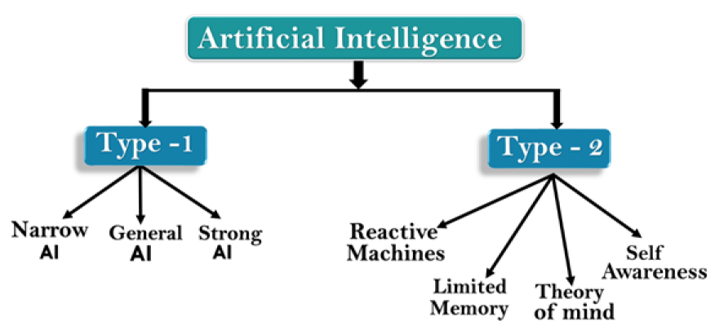
Types of AI
Notes:
Category 1 (Type 1) & Category 2 (Type 2)
Type 1: Based on Capability → Based on what they are capable of doing.
Type 2: Based on Functional Quality → Based on how elegantly (qualitatively) they can do their functions.
As we go from left to right in the diagram (for each type), capability and functional quality increases.

Slide 34
Type 1: Based on Capabilities
Weak or Narrow AI: is a type of AI which is designed to perform a dedicated task with intelligence. The most common and currently available AI is Narrow AI. It cannot perform beyond its field or limits, as it is only trained for a specific task.
Notes:
Narrow AI can fail in unpredictable ways if it goes beyond its limits.
Apple Siri is a good example of Narrow AI, and it operates with a limited pre-defined set of capabilities.
IBM's Watson supercomputer also comes under Narrow AI, as it uses an Expert system approach combined with Machine learning and natural language processing.
Other examples of Narrow AI are Google translate, playing chess, purchasing suggestions on e-commerce sites, self-driving cars, speech recognition, and image recognition.
Humans can possess a body of knowledge and can add more with no problem.
Intelligence: the ability to acquire and apply knowledge and skills. Oxford dictionary

Slide 35
Type 1: Based on Capabilities
General AI: This is a type of intelligence that could perform any intellectual task with efficiency, like a human. The idea behind general AI is to make a system that could be smart and think like a human on its own.
Notes:
Currently, there is no such existing system which could come under general AI that can perform any task as seamless as a human.
It may arrive within the next 20 years but it has challenges relating to hardware, energy consumption required in today’s powerful machines, and the need to solve catastrophic memory loss that affects even the most advanced deep learning algorithms of today.
Researchers are currently focused on developing machines with General AI.

Slide 36
Type 1: Based on Capabilities
Super (Strong) AI: This is a level of Intelligence at which machines could surpass human intelligence, and can perform tasks better than humans with cognitive properties. This refers to aspects like general wisdom, problem solving and creativity.
Notes:
Some key characteristics of strong AI include capability to think, to reason and solve puzzles, make judgments, plan, learn, and communicate independently.
Cognitive: Reasoning, thinking, rational thought, perceiving, intellectual behavior, learning.
Cognition: the mental action or process of acquiring knowledge through thought, experience, and the senses.
Intelligence: the ability to acquire and apply knowledge and skills. Oxford dictionary

Slide 37
Type 1: Based on Capabilities
Super (Strong) AI: This is a level of Intelligence at which machines could surpass human intelligence, and can perform tasks better than humans with cognitive properties. This refers to aspects like general wisdom, problem solving and creativity.
Notes:
Super AI is essentially an outcome of General AI.
Super AI is still a hypothetical concept of Artificial Intelligence. If successful, it could definitely be highly disruptive.
This type of AI may cause (may be highly disruptive): Social ills, Unemployment, or End of humanity.
According to weak AI, the principal value of the computer in the study of the mind is that it gives us a very powerful tool.
For example, it enables us to formulate and test hypothesis (model) in a more rigorous and precise fashion.
But according to strong or general AI, the computer is not just a tool in the study of the mind; rather, the appropriately programmed computer is a mind.

Slide 38
Type 2: Based on Functional Qualities
Reactive Machines: These are the most basic types of AI currently developed.
Do not store memories of past experiences for future use.
Only focuses on current scenarios and react with their best possible options.
IBM's Deep Blue system & Google’s AlphaGo are example of reactive machines.
Notes:
They do not learn.
Deep Blue can be considered as an Expert System Chase Player machine.
Functional Qualities: How elegantly they can do their functions.

Slide 39
Type 2: Based on Functional Qualities
Limited Memory: These machines can store past experiences or some data for a short period of time.
Self-driving cars are one of the best examples of such systems.
Notes:
These cars can store recent speeds of nearby cars, distance of other cars, speed limits, and other information to navigate the road.

Slide 40
Type 2: Based on Functional Qualities
Theory of Mind: This type of AI would understand human emotions, beliefs, and be able to interact socially like humans.
Notes:
This type of machines are not still realized, but researchers are making lots of efforts and progress is being made.

Slide 41
Type 2: Based on Functional Qualities
Self-Awareness: This type of AI is the future of Artificial Intelligence. These machines will be super intelligent and will have their own consciousness, sentiments, and self-awareness.
Notes:
These machines will be smarter than the human mind.
Self-Awareness AI is a hypothetical concept and does not exist in reality at this moment.
Sentiment: a view or opinion that is held or expressed.
Sentiments: Semietoch!

Slide 42
Activity
From our discussions, General AI could perform intellectual tasks with comparable efficiency to humans. So, to achieve this intelligence level, do you think that future AI must mimic the way humans think? Why and why not?
Notes:
Can you imagine any other way of achieving human comparable intelligence?
For example, Animals have powers which humans don’t.
Such as sensing imminent natural dangers, and taking appropriate actions.
Do plants have intelligence?

Slide 43
Mapping Human’s Thinking to AI Components
So, AI was defined as:
The study of ideas that enable computers to be as intelligent as humans.
Part of computer science concerned with design of computer systems that exhibit human intelligence. (Concise Oxford Dictionary)
Notes:
1. Study the intelligent characteristics concerned with humans.
2. Represent those qualities using computers.
What are the components (attributes/characteristics/qualities) of intelligence?
Reasoning, Learning, Problem Solving (or Taking Actions), Perception, Linguistic Intelligence

Slide 44
Mapping Human’s Thinking to AI Components
From the previous two definitions, we can see that AI has two major roles
Study the intelligent part concerned with humans.
Represent those qualities (components) using computers.
Notes:
What are the components (attributes/characteristics/qualities) of intelligence?
Reasoning, Learning, Problem Solving (or Taking Actions), Perception, Linguistic Intelligence
Human intelligence represented with robots.

Slide 45
How Do Humans think?
Intelligence or the cognitive process is composed of three main stages:
Observe and enter input information or data to the brain (sensing).
Interpret and process the perceived input, and evaluate the outcome.
Take actions or make decisions based on your cognition of the whole process.
Notes:
AI researchers are simulating the same stages in building AI systems or models.
This process represents the three main layers or components of AI systems.
Sensing layer, Interpretation layer (Reasoning & Thinking layer…), and Interacting (action) layer.
Cognition: the mental action or process of acquiring knowledge and understanding through thought, experience, and the senses.

Slide 46
Influencers of AI
Big data
Advancements in computer processing speed and new chip architectures
Cloud computing and APIs
Emergence of data science
Notes:
Some of the reasons why AI is taking off (getting momentum) now is because of these drivers.
Big data refers to huge amounts of data (as a result of IR4). Big data requires innovative forms of information processing to draw insights, automate processes, and help decision making. Thus, it requires AI. Big data is one of the drivers of AI.
The exponential growth of unstructured and semi-structured data drives the need for a new kind of computer system. Like distributed clustered computing and AI. In the past, one of the barriers to the growth of AI was lack of data availability.
[Q] What are the drivers (influencers/enablers) of Big data? IR4, IOT, and the many sources of large volumes of data.

Slide 47
Influencers of AI
Big data
Advancements in computer processing speed and new chip architectures
Cloud computing and APIs
Emergence of data science
Notes:
[Q] Why does the advancement in computer processing speed (or power) and architecture influence AI?
Advancements in computer processing and memory speeds enable us to make sense of the information that is generated by big data more quickly.

Slide 48
Influencers of AI
Big data
Advancements in computer processing speed and new chip architectures
Cloud computing and APIs
Emergence of data science
Notes:
Let us see what the cloud is in the next slide.
And explain Cloud computing and APIs accordingly.

Slide 49

Notes:
What is the cloud? What is cloud computing?
"The cloud" refers to servers that are accessed over the Internet, and the software and databases that run on those servers.
Cloud servers are located in data centers all over the world.
Cloud computing is a general term that describes the delivery of on-demand services, usually through the internet, on a pay-per-use basis.
By using cloud computing, users and companies don't have to manage physical servers themselves or run software applications on their own machines.

Slide 50
Influencers of AI Cont.
Big data
Advancements in computer processing speed and new chip architectures
Cloud computing and APIs
Emergence of data science
Notes:
Companies worldwide offer their services to customers over cloud platforms. These services might be data analysis, social media, video storage, e-commerce, and AI capabilities that are available through the internet and supported by cloud computing.
[Q] I hope you remember, SaaS, PaaS, and IaaS; What are these services? What is the core element of cloud computing?
Virtualization is the core component of cloud computing.
[Q] What is virtualization?
Cloud computing is a general term that describes the delivery of on-demand services, usually through the internet, on a pay-per-use basis.
Application programming interfaces (APIs) expose capabilities and services. (Service Outlets).
Based on the principle of Service Oriented Architecture (SOA) style. Composition & Orchestration.
APIs enable software components to communicate each other easily.
APIs abstract the underlying workings of a service, application, or tool, and expose only what a developer needs, so programming becomes easier and faster.

Slide 51
Influencers of AI Cont.
All the big companies in the AI services market deliver their services and tools on the internet through APIs over cloud platforms:
IBM delivers Watson AI services over IBM Cloud.
Amazon AI services are delivered over Amazon Web Services (AWS).
Microsoft AI tools are available over the MS Azure cloud.
Google AI services are available in the Google Cloud Platform.
Notes:
Cloud Computing Continued…
These services benefit from cloud platform capabilities such as: Availability, Scalability, Accessibility, Rapid deployment, flexible billing options, simpler operations, and management.

Slide 52
Influencers of AI
Big data
Advancements in computer processing speed and new chip architectures
Cloud computing and APIs
Emergence of data science
Notes:
Data science has emerged as a new profession that combines several disciplines, such as statistics, data analytics, machine learning, and others.
As we already know data science is about the extraction of knowledge from big data.
After large volume of data is collected, patterns emerge. Then, data scientists use learning algorithms on these patterns to extract knowledge.
Data science uses machine learning and AI to process big data. Thus, influencing AI.

Slide 53
Reading Assignment:
Applications of AI (Section 3.6) This part is left as a reading assignment for you.

Slide 54
AI Tools and Platforms
AI platforms are defined as some sort of hardware architecture and/or software framework (including application frameworks), that allows AI software to be initialized, trained, tested and deployed.
Notes:
What do you know about a platform? Why we need platforms?
Can you name some platforms you used previously or you know about?
For example, Software Development Platforms?
JEE and Microsoft .NET Platforms.
AI platforms simulate the cognitive function that human minds perform such as problem-solving, learning, reasoning, social and general intelligence.
AI platforms are made up of tools and algorithms.

Slide 55
AI Tools and Platforms
An AI platform is a set of services that support the machine learning life cycle. This includes support for gathering and preparing data as well as training, testing, and deploying machine learning models for applications at scale.
Notes:
Artificial intelligence (AI) platforms provide users a tool kit to build intelligent applications.
AI platforms encompass components that enable visual and conversational design work for an AI solution.
These platforms combine intelligent, decision-making algorithms with data, which enables developers to create AI business solutions.
Some platforms offer pre-built algorithms and simplistic workflows with features like drag-and-drop modeling, and visual interfaces that easily connect necessary data to the end solution.
These algorithms can include functionality for image recognition (useful for criminal identification, for example), NLP (gives machines the ability to read/sense and understand human language).
Some applications of NLP include information retrieval, text mining, question answering, machine translation, and voice recognition.

Slide 56
AI Tools and Platforms
AI platforms are frequently used by developers to create both the learning algorithms and intelligent applications.
Notes:
But, users without intensive development skills will benefit from the platforms’ pre-built algorithms and other features that minimize the learning curve.
AI platforms are very similar to Platforms as a Service (PaaS), which allow basic application development, but these products differ by offering machine learning options.

Slide 57
AI Tools and Platforms
AI has developed a large number of tools to solve the most difficult problems in computer science, like:
Search and optimization
Logic
Probabilistic methods for uncertain reasoning
Classifiers and statistical learning methods
Neural networks
Control theory
Languages
Notes:
The most common artificial intelligence platforms include Microsoft AZURE Machine Learning, Google Cloud Prediction API, IBM Watson, TensorFlow, Infosys Nia, Wipro HOLMES, API.AI, Premonition, Rainbird, Ayasdi, MindMeld, and Meya.
Optimization: make the best or most effective use of a situation or resource.
Logic: the quality of being justifiable by reason.
: reasoning conducted or assessed according to strict principles of validity.
Languages: Natural Languages

Slide 58
Search
Search is a fundamental technique (procedure) of AI.
Possible answers, decisions or courses of action are structured into an abstract space, which we then search.
Search is either "blind" or “informed":
Blind Search
we move through the space without worrying about what is coming next, but recognising the answer if we see it
Informed Search
we guess what is ahead, and use that information to decide where to look next.
We may want to search for the first answer that satisfies our goal, or we may want to keep searching until we find the best answer.
Notes:
If we consider search, for example, the machine might follow the steps shown here to provide answers for search requests.
As we can observe, Informed search is optimized than Blind search.

Slide 59
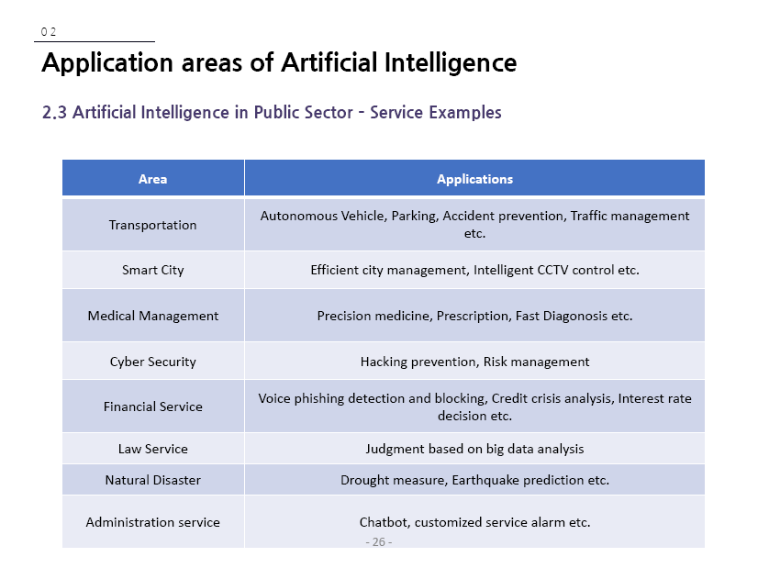

Example AI Applications
Notes:
[Q] What are the characteristics of a smart city? What makes a city smart?
Smart: Connected, safe, managed, convenient for its residents in all aspects.
All services are easily available, efficient and are supported by Information Communication Technologies.
All Services are IoT and AI supported.
Efficient Transportation can be considered as one component of smart city.
In Medical Management as Expert Systems or Decision Support Systems.
Phishing: the fraudulent practice (cyber crime) of sending emails purporting to be from reputable companies in order to induce individuals to reveal personal information, such as passwords and credit card numbers.

Slide 60
Sample AI Applications
Commuting
Google’s AI Platform Predictions
Ridesharing Apps Like Uber and Lyft
Commercial Flights Use an AI Autopilot
Notes:
Commuting: travel to and from work, travel to and fro between places.
Google launched AI Platform Predictions in general availability, a service that lets developers prep, build, run, and share machine learning models in the cloud.
Google Maps Driving Mode estimates where you are headed and helps you navigate the surrounding area.
Google Search Engine is powered by AI.
Google Translate uses an artificial neural network called Google Neural Machine Translation (GNMT) to increase fluency and accuracy of translations.
And many more AI applications …

Slide 61
Sample AI Applications
Commuting
Google’s AI-Powered Predictions
Ridesharing Apps Like Uber and Lyft
Commercial Flights Use an AI Autopilot
Notes:
These apps work worldwide, so you can count on Uber to get you home even if you’re in a foreign country.
We have mentioned the Autopilot thing many times.

Slide 62
Sample AI Applications
Email
Spam Filters
Smart Email Categorization
Social Networking
Online Shopping
Smartphone Features
Notes:
Spam Filters (unwanted email filters) and Smart Email Categorization use AI technologies.
[Q] What does Facebook use AI for?
Facebook uses AI for friend suggestions.
Pinterest uses computer vision (an AI application where computers are taught to see) to recommend similar objects in images.
Instagram uses machine learning to identify the contextual meaning of emoji (for example, a laughing emoji could replace “lol”).
And So On…
[Q] What are the basic (essential) tools or features of AI for an Online shopping?
Search and Recommendation.

Slide 63
Sample AI Applications
Email
Social Networking
Online Shopping
Search
Recommendations
Smartphone Features
Notes:
Search - Amazon searches, for example, quickly return a list of the most relevant products related to your search.
Recommendations - Amazon uses artificial neural networks to generate product recommendations.
Using phrases like “customers who viewed this also viewed” and “customers who bought this also bought”

Slide 64
Sample AI Applications
Email
Social Networking
Online Shopping
Search
Recommendations
Smartphone Features
Notes:
Voice-to-Text: Currently a standard feature on smartphones.
Thus, basic conversation (voice command) has become the control interface for a new generation of smart personal assistants.
Examples are Siri, Google Now, Google Assistant, Alexa which has question answering capabilities via internet searches.
Echo smart speakers allow you to integrate Alexa into your living room and use voice commands to ask natural language questions, play music, order pizza, signal an Uber to stop, and integrate with smart home devices.

Slide 65
Assignment 2
Make a research how Ridesharing Apps Uber and Lyft are working. Describe platforms and frameworks available to develop such systems. Is it possible to develop ridesharing apps using open platforms and frameworks? Can you try and demonstrate one, for a bonus mark?
It is not allowed to deliver similar works in any form as usual. Thus, your work should be unique. Deadline: 15 days from now.
Notes:
If you are the designer of your work, it will be unique.
Try to follow document writing structure rules as much as possible.
Such as, introduction, discussion, conclusion, references.
Your cited references should be accessible.
Cite (mention) your source whenever you use the work of others, and that is usually the case.
Delivery date: 15 days from today, on march 16, 2021.

